Slide 1
Notes:
Hi we are NAME OF SCHOOL's Netsafe Youth Action Squad

Slide 2
Put a picture of your group here

Slide 3
of young people spend 4 or more hours in an average day on a device
(not related to any time in the classroom/ learning space)
Notes:
We know that everyone our age is online in some way

Slide 4
When did you last…
send or post something and then wish you could take it back?
Notes:
Sometimes we share or post something because in the moment it seems funny. The way the online world works makes it almost impossible to get things back.
We don’t all think the same and so we don’t react to things in the same way either. Something that you think is funny might not seem quite so hilarious to the person who is on the receiving end.

Slide 5
Are you mindful that not everyone is who they appear to be online… and not everything we read is reliable?
Notes:
Do you think carefully about things online when you see them?

Slide 6
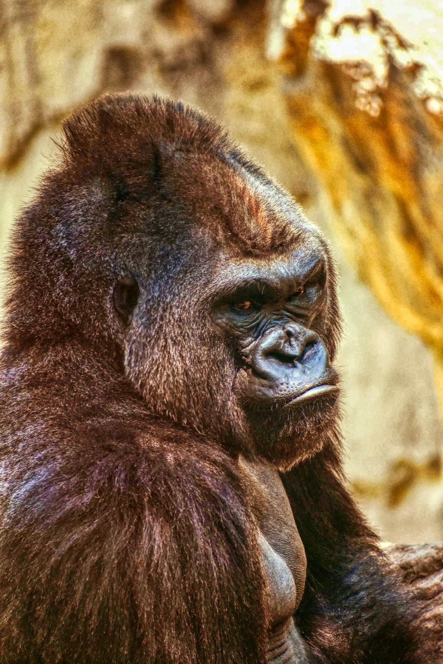
When did you last…
get upset about something you saw online?
Notes:
When did you last…get upset about something you saw online?
What we want and plan to see is not always what ends up happening.

Slide 7
We want to create a culture of kindness online
Notes:
We want to help people have a nice time and be safer online

Slide 8
Look for our badges!
Notes:
We are here to talk to as well
You can spot us by the badge on our uniform, which looks like a shield
Keep an eye out for our activites and events in the school as well!

Slide 9
Notes:
We are supported by Netsafe. You can always get in touch with them if you are upset about something happening online.
If you want to know more about our school YAS, you can ask NAME OF THE STAFF MEMBER SUPPORTING YOUR GROUP
Thank you for your time!

